Slide 1

MLB ERA Predictions
An Evaluation of pitchers across 2012 – 2022.

Slide 2
Basis
The study is derived from a Ridge Regression that evaluates the factors that add value to the Chinese Sports Industry.
This research by Jiaomu Li, Sen Huang, Sicheng Min & Te Bu analyzed factors influencing the development of the sports industry from 2010 – 2019.
The goal of this research was to analyze the relationship and evaluate the correlation between the factors and the value added to the sport’s industry.

Slide 3
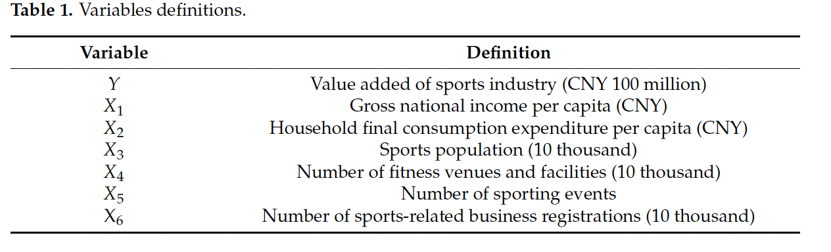
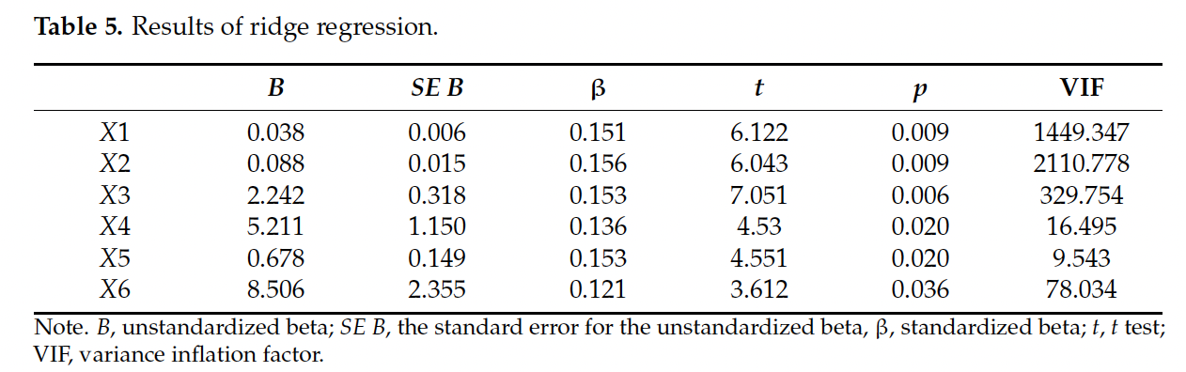
Factors & Results

Slide 4
Earned Run Average Predictions
ERA (Earned Run Average): The average number of earned runs a pitcher allows per 9 innings. ((ER*9)/IP)
Imported data from a python built in library called ‘pybaseball’
Modelled it with some criteria and specified years.
Cleaned, Transformed and prepared it for machine learning.
Ran a ridge regression where I predicted the ERA of pitchers on test data to evaluate accuracy.
Ran an OLS Regression to evaluate independent variables’ significance to the target.

Slide 5
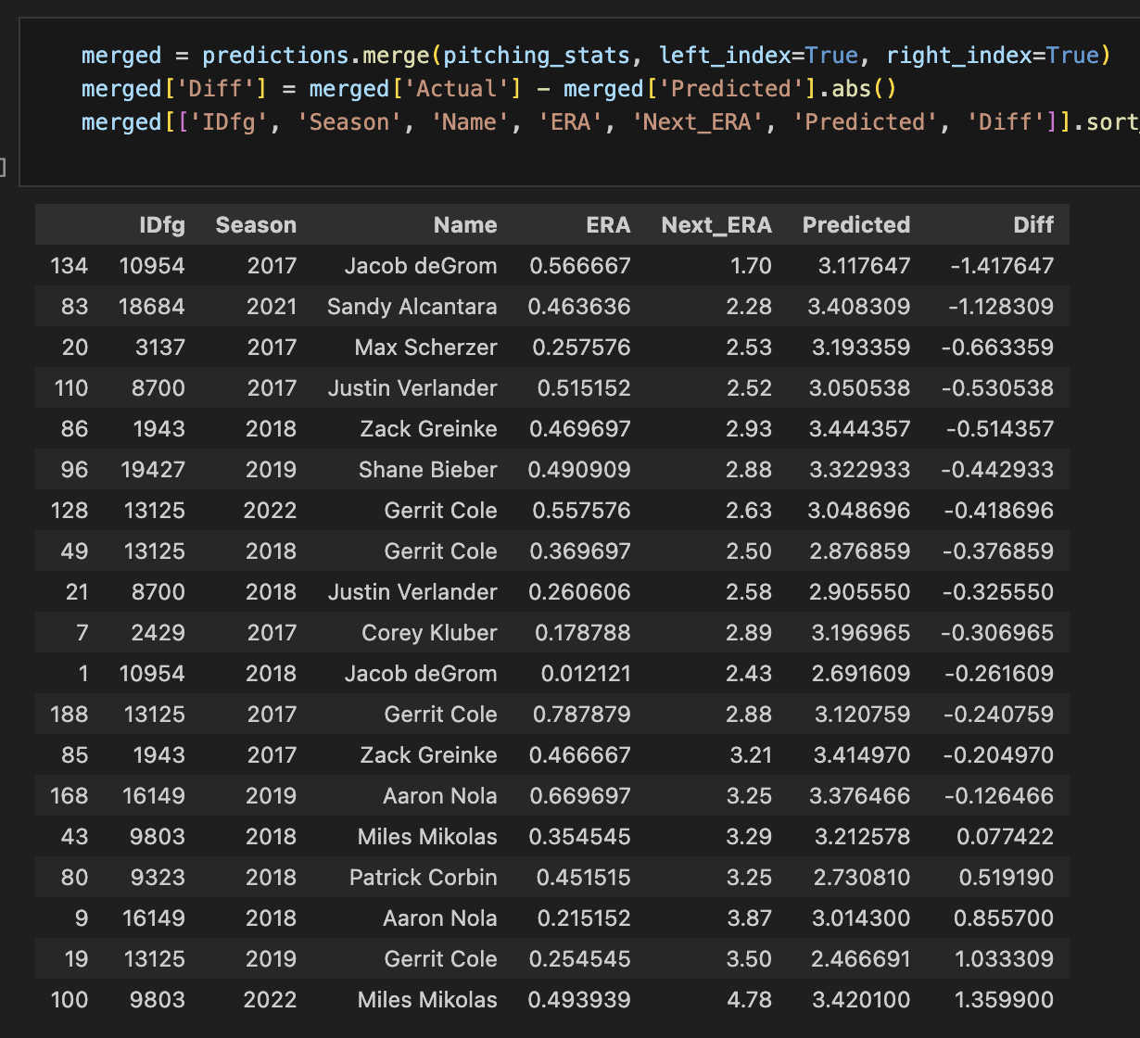
Prediction Results
Used the first 5 years to predict the next year target, then incrementally added the predicted year to use in predicting future years.
Predictions appeared to be decent returning a mean squared error (MSE) of 0.4785

Slide 6
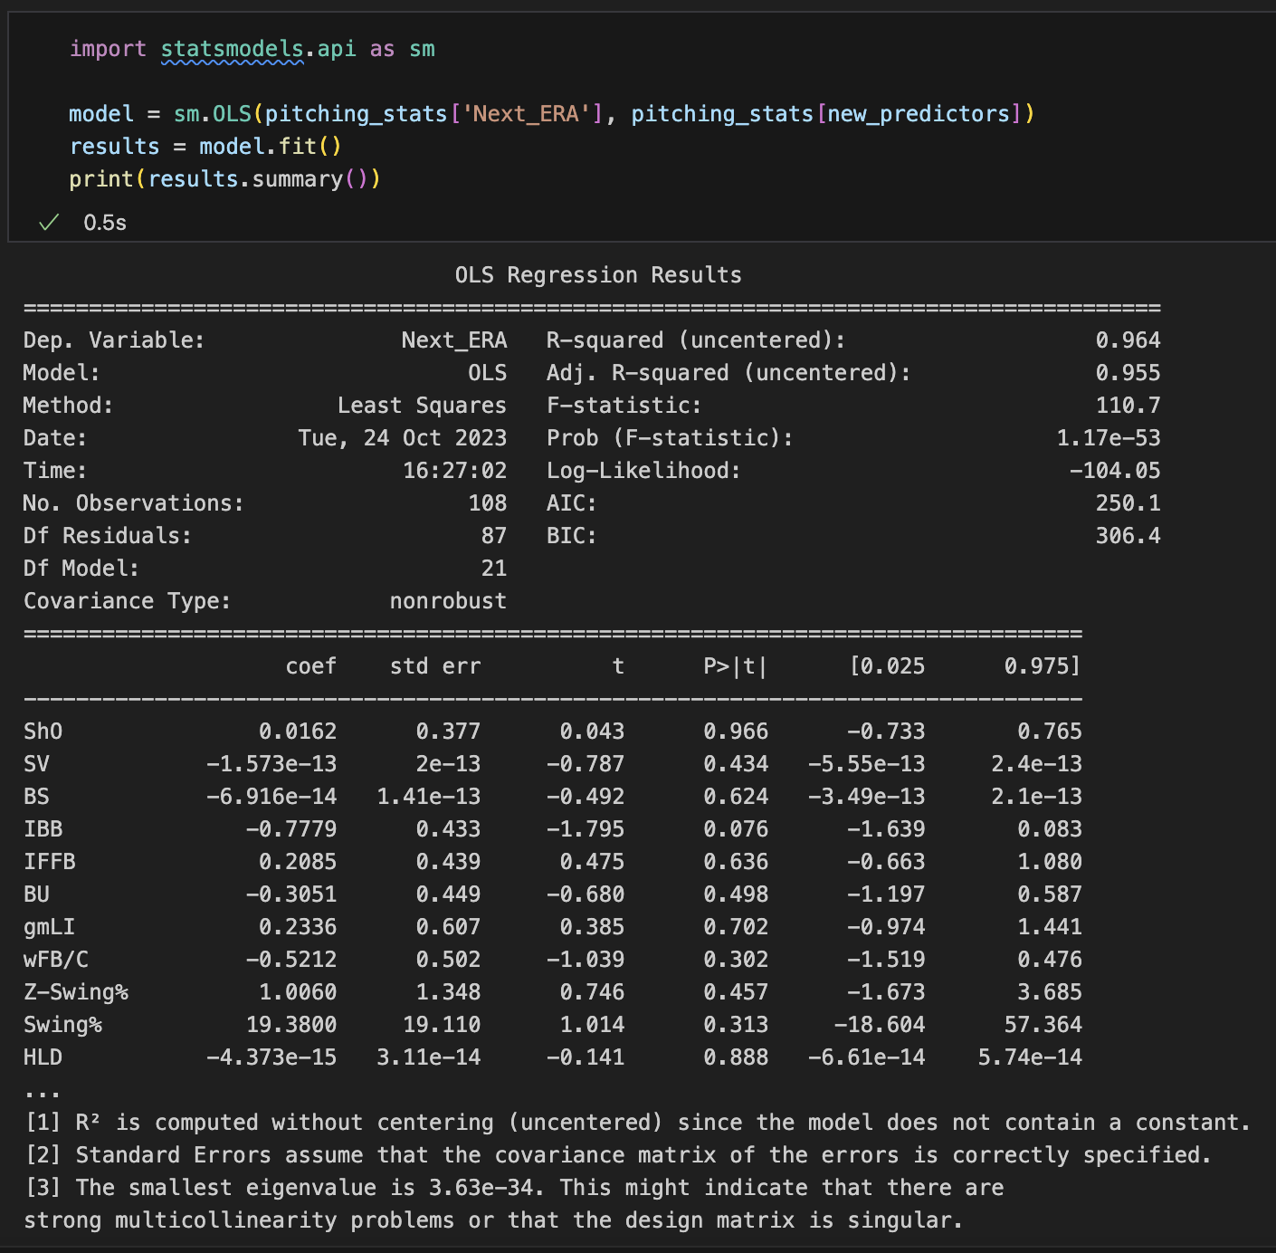
Cont’d
The Significant Variables (<10%) appear to be:
IBB (Intentional Walks)
E-F (ERA – FIP Differential)
Z-Swing% (Inside the zone swing Percentage)
Frm (Framing)
LOB % (Left on base percentage)

Slide 7
Thank you, Questions?

